Slide 1
PEOPLE’S HEALTH

Slide 2
Team Members
Akshatha,
Anita Maria D’Souza,
Athira M Saseendran,
Meghana S Bangera,
Ramya

Slide 3
Introduction
The main objective of this project is to develop an application that enables patients to view hospital details, book and pay for their appointments, and also to post online feedback and queries.
The admin can perform operations such as adding doctor details, replying to the feedbacks and enquiries made by the end-user as well as managing user appointments.

Slide 4
Problem Statement
An Application for the patient to book and pay for hospital appointments.
An Application for the admin to manage appointment and doctor details.
An Application that helps the users to view hospital details, and also post hospital-related feedback and queries.

Slide 5
Scope of the Project
This application will allow users to book online appointments and pay for the same online as well as post feedbacks and queries about the hospital
The application will be useful to the admin to add doctor details, manage appointment information and respond to user-end feedbacks.

Slide 6
Technology Stack Used
MiddleWare
Java 8.x
Spring 5.1.9
Spring Boot 2.1.8
Eureka Discovery Client
JPA
Zuul Server
Lombok
BackEnd
MySQL
Front End
HTML5
CSS3
JavaScript
TypeScript
Bootstrap 4
Angular 8

Slide 7
Class Diagram

Slide 8
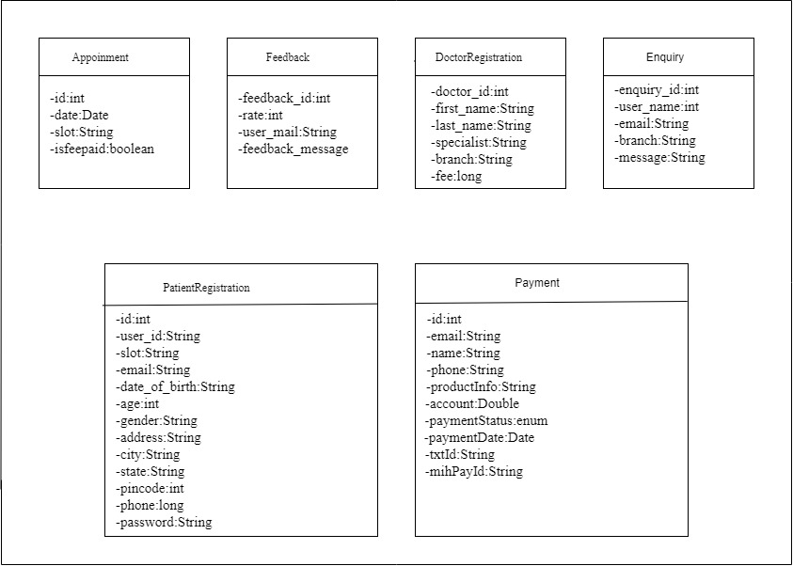
.

Slide 9
Microservice Architecture

Slide 10
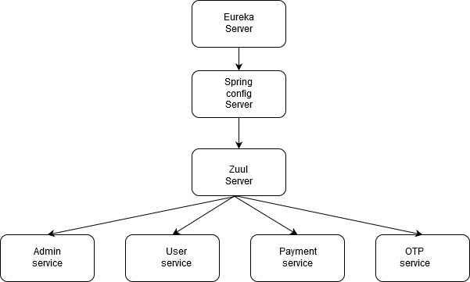

Slide 11
Screenshot showing instances currently registered with Eureka server

Slide 12
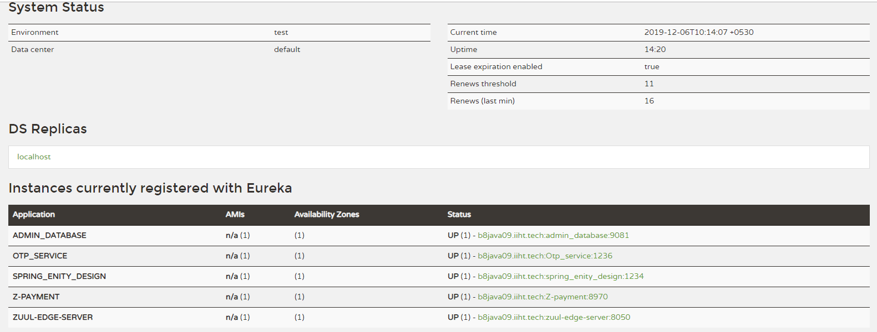

Slide 13
Angular Architecture

Slide 14
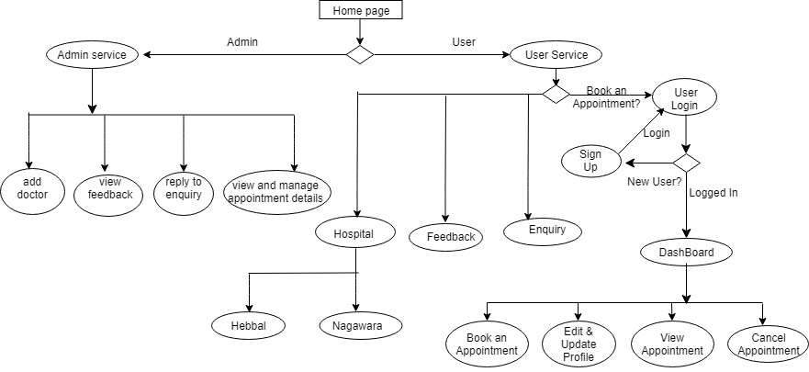
.

Slide 15
Deployment
DataBase:https://us-east-2.console.aws.amazon.com/rds/home?region=us-east-2#databases: (Amazon AWS)
Instance - database-1.cjf8p0uqfj31.us-east-2.rds.amazonaws.com
Port – 3306
User Service: https://peolpeshealthdemo.cfapps.io/
Admin Service:https://admin-backend-12nn.cfapps.io/
OTP Service: https://peopleshealthotp.cfapps.io/
Payment Service: https://peopleshealthpayment.cfapps.io/
Angular: http://hospitalappointment3.cfapps.io/

Slide 16
TESTING
Junit test
Unit testing with Mockito

Slide 17
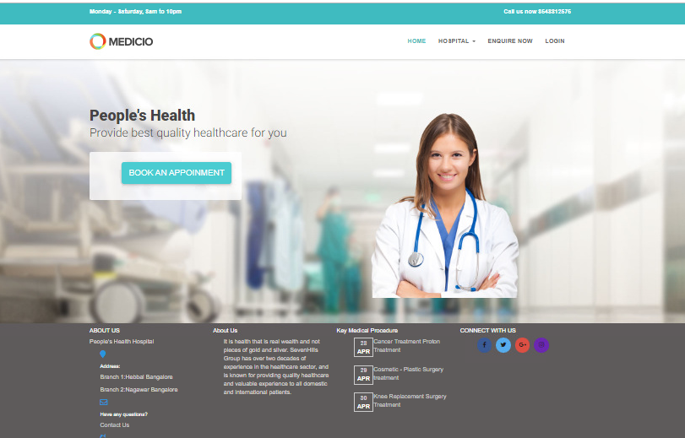
Demo
Let’s get into the Project to have a better understanding!

Slide 18
Future Scope
Online consultation with the doctor which enables the patient to discuss concerns with doctor and obtain advice.

Slide 19
Thank you!

